Slide 1

CSCI E-25 Computer Vision
Object Detection
Steve Elston
Copyright 2020, 2021,2022, 2023, 2024, Stephen F Elston. All rights reserved.

Slide 2
Overview of Object Detection
Goal of object detection is to localize and identify objects in an image
Real-world scenes are complex with multiple objects
Localizing and identifying multiple objects is key to scene understanding
Task related to semantic segmentation
Localization parameterized by bounding box
Is a dense CV task
Object detection and segmentation are dense CV tasks
Classification is not dense
Objects can occur anywhere in an image
Localize objects to pixel-level
Classification does not require pixel-level accuracy

Slide 3
Overview of Object Detection
Goal of object detection is to find, localize and identify objects in an image
Is a multi-task AI problem
Finding numeric values of bounding box location and dimensions is a regression problem
Identification of objects in bounding boxes is a classification problem
Training models requires a multi-task loss function!
Try it yourself! Object detection is widely used commercially
https://cloud.google.com/vision/automl/object-detection/docs/
https://docs.microsoft.com/en-us/azure/cognitive-services/custom-vision-service/get-started-build-detector
https://huggingface.co/models?pipeline_tag=object-detection

Slide 4

Overview of Object Detection
As alternative can use semantic segmentation – closely related algorithms
Semantic segmentation is a primary tool for scene understanding
More on this method in another lesson

Slide 5

Overview of Object Detection
Object detection is a hard problem - Real-world scenes are cluttered
Hard to uniquely detect and classify all objects
This object is both a vase and a potted plant

Slide 6
Lesson Overview
Elements of object detection algorithms
Parameterization of bounding boxes
Evaluation of object detection algorithms
Multiple prior bounding boxes
Solving the object detection problem
Working with multiple scales
Single-shot algorithms for video
Transformer architectures

Slide 7
Overview of Object Detection
What approaches might be used to find objects in a complex scene?
Example: Classical approach
Compute features – e.g. HOGs
Search to localize objects
Classify objects detected
Example: Classical approach
Compute embedding – e.g. PCA
Locate similar patches
e.g. the eigen-faces algorithm
Use deep neural networks
Dramatic increase in accuracy
speed may be sacrificed
Create feature map with CNN
Localize and classify objects

Slide 8
Elements of Object Detection Algorithms
Object detection algorithms have some common elements
Convolutional Neural Network: CNN backbone creates a feature map which is used to detect and classify objects
Candidate bounding boxes: Candidate bounding boxes are generated for each region
Bounding box maximal suppression: Probability of an object being in each bounding box (objectness) is computed, and low probability boxes are suppressed
Minimal bounding boxes: The size of the bounding boxes is adjusted to best fit the objects
Identification: Classify the object in each bounding

Slide 9

Object Detection Pipeline
Major components common to most object detection pipelines
Bounding box regression
Object classification
Input Image
Inferred outpu
Cat, mouse, book
Backbone
creates multi-scale feature map
Neck integrates scales
Task-specific head

Slide 10

Overview of Object Detection
Object detection is a hard problem - Occultation is common in real-world scenes
How many people are in this scene?
Are these heads or people?
What is this object?

Slide 11
Overview of Object Detection
Object detection is a hard problem – Trade-offs of speed, categories and accuracy
Selection of object detection models has multi-dimensional trade-offs
Less confidence in classification with increasing number of categories
Lower complexity straight-through models are faster
Chose model to meet requirements
Complex multi-step models
Increasing model complexity
Increasing number of categories
Increasing confidence –
Classification accuracy
Single shot detectors
Increasing frame rate - speed

Slide 12
Evolution of Object Detection Algorithms
An incomplete list of seminal object detection algorithms
Erhan et. al., 2013, Scalable Object Detection using Deep Neural Networks, introduced the R-CNN algorithm the first widely accepted deep learning object detection algorithm. R-CNN demonstrated a significant improvement in object recognition accuracy over classical methods. However, this algorithm is too slow for real-time video processing.
Girshick, 2015, Fast R-CNN simplified the required computations but still too slow for real-time video.

Slide 13
Evolution of Object Detection Algorithms
An incomplete list of seminal object detection algorithms
Ren et. al., 2016, Faster R-CNN algorithm, but computational complexity of the algorithm was still rather high.
He, et. al. in 2018 Mask R-CNN algorithm exhibits significantly improved object detection accuracy, particularly when there are large numbers of objects, such as flock of birds or a crowd of people. Not efficient enough for real-time video, but accurate for complex scenes

Slide 14
Evolution of Object Detection Algorithms
An incomplete list of seminal object detection algorithms
Single shot real-time object detection algorithms
Lui et. al., 2016, Single shot Multibox Detector performs bounding box fitting, object detection, and classification in one step. This single shot algorithm provides real time performance for video
Redmon, et. al. 2016, You Only Look Once: Uniﬁed, Real-Time Object Detection (YOLO) is an alternative single shot detector. YOLO version 1 suffered from low accuracy
Redmon, et. al., 2016, YOLO 9000: Better, Faster, Stronger (aka YOLO v2) made several improvements over the original algorithm. Included the combination of efficient CNN, larger, integrated training data set.

Slide 15
Evolution of Object Detection Algorithms
An incomplete list of seminal object detection algorithms
Single shot real-time object detection algorithms
Redmon, et. al., 2016, YOLOv3: An Incremental Improvement, primarily new CNN.
Lin, et. al., 2018, Focal Loss for Dense Object Detection
Bochkovskiy, et. al., 2020, YOLOv4: Optimal Speed and Accuracy of Object Detection
YOLOv5, YOLOv6, YOLOv7, YOLOv8, YOLOv9, Wang et.al., 2024, and many other YOLO spin-off versions
Chen, et. al., 2022 proposed a simplified transformer architecture for dense CV tasks. May point toward the future

Slide 16
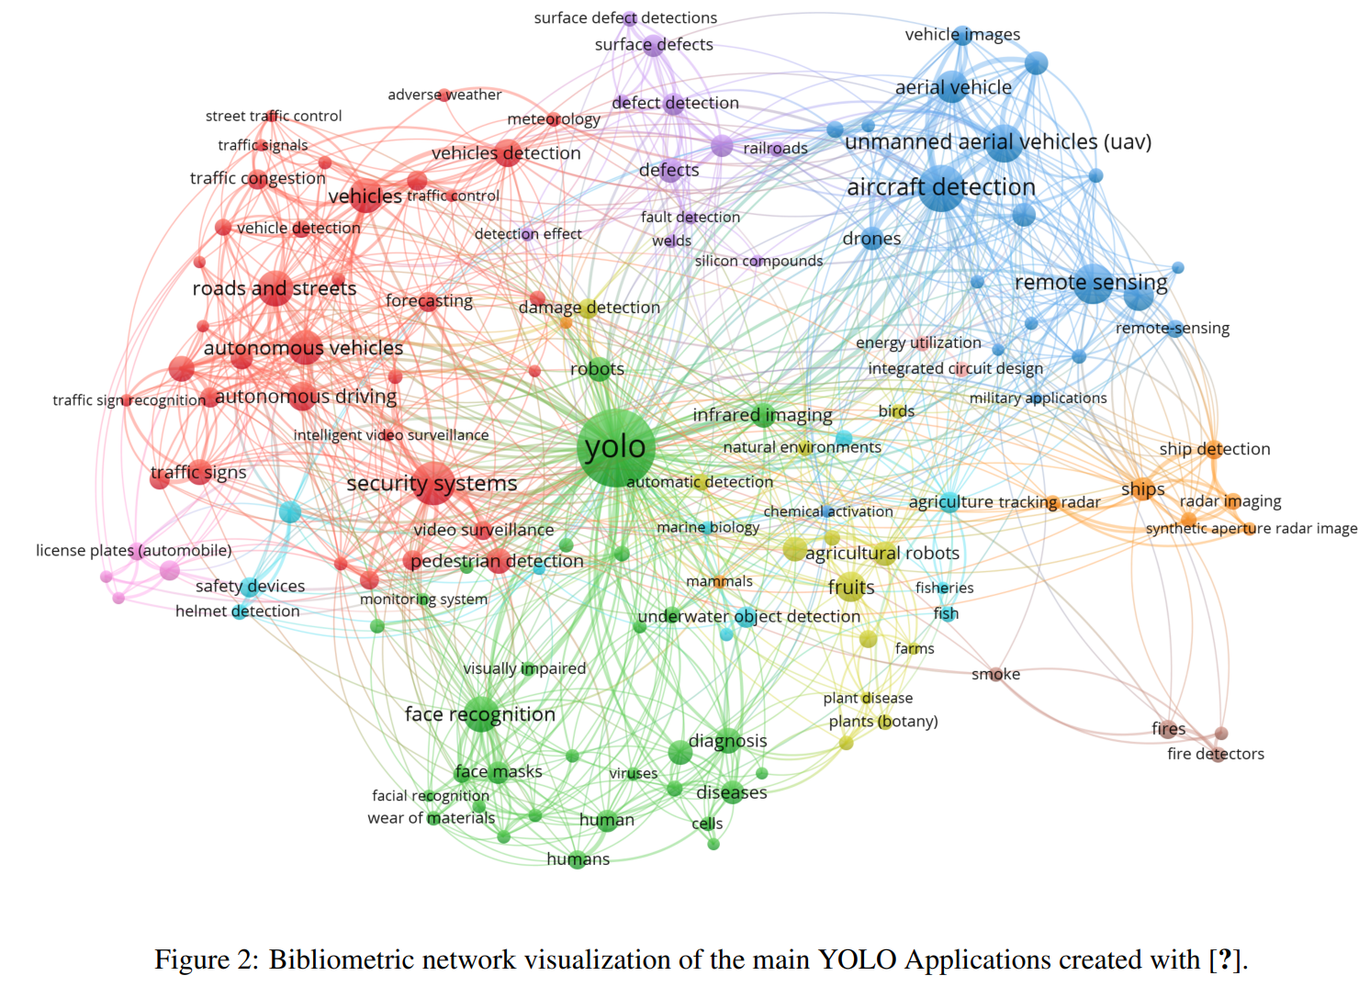
The Object Detection Literature is Extensive
Continued advances in the YOLO family of real-time object detectors has created a tangle of models and published literature!
It is very hard to keep up!
From YOLO Architecture review paper, Terven and Cordova-Esparza, 2024

Slide 17
Parameterization of Bounding Boxes
Need a stable parameterization of 4 parameters of bounding box
Start with a prior, prototype, or anchor for the bounding box
c_{x}, c_{y} is center of the prior
p_{w} is the width prior
p_{h} is the height prior
The compute the best fit box
b_{x}, b_{y} is center of bounding box
b_{w} is the width of the bounding box
b_{h} is the Hight of the bounding box
p_{w}
p_{h}
c_{x}, c_{y}
b_{x}, b_{y}
b_{h}
b_{w}

Slide 18

Parameterization of Bounding Boxes
Need a stable parameterization of 4 parameters of bounding box
A naive approach is to solve a linear system of equations for parameters, t_{x}, t_{y}, t_{u}, t_{h}:
But parameters of the bounding box are unconstrained!
Solution can be unstable
p_{w}
p_{h}
c_{x}, c_{y}
b_{x}, b_{y}
b_{h}
b_{w}

Slide 19

Parameterization of Bounding Boxes
Need a stable parameterization of 4 parameters of bounding box
A better parameterization is proposed:
The bounding box is now constrained and the parameterization is stable
p₀ is the probability the box contains an object
p_{w}
p_{h}
c_{x}, c_{y}
b_{x}, b_{y}
b_{h}
b_{w}

Slide 20
Evaluation of bounding box proposals
How can we evaluate bounding boxes computed with object detection?
Compare the computed bounding box with the marked bounding box (label)
Use the ratio of the area of the intersection divided by the area of the union
Intersection over union or IoU metric
Range:
0.0 – no overlap
1.0 – perfect match

Slide 21

Evaluation of bounding box proposals
How can we evaluate bounding boxes computed with object detection?
Intersection
Union

Slide 22

Evaluation of bounding box proposals
How can we evaluate bounding boxes computed with object detection?
The closer the prediction is to the ground-truth bounding box the higher the IoU
We say higher IoU predictions have greater confidence
Figure from Balasubramaniam and Pasricha, 2022

Slide 23
Multiple Prior Bounding Boxes
Images can contain many objects
SSD uses a grid to divide the image
Can fit bounding boxes around centroids in each of the grid cells
Use odd grid dimensions so there is a centroid at the center of image

Slide 24
Multiple Prior Bounding Boxes
Images contain many objects
Impose grid over image
Locate objects on the grid

Slide 25
Multiple Prior Bounding Boxes
There are many possible bounding box proposals
Start with a first bounding box proposal, with centroid
Boxes with different aspect ratios and same centroid
Apply non-maximal suppression to box estimates using proposals as prior

Slide 26
Multiple Prior Bounding Boxes
Multiple objects in image
Bounding box prototypes center on grid elements
Multiple prior bounding box candidates
SSD uses multiple grids to accommodate multiple scales

Slide 27

Finding Priors for Bounding Boxes
Good priors are required for solution
Priors for VOC and COCO for YOLO models
For both data sets, tall and narrow priors are favored

Slide 28

Performance comparison and trade-offs
YOLOv2 (9000) uses overlapping bounding boxes at multiple scales
Starts with a grid of anchor boxes on a single grid
Priors for multiple scale bounding boxes around anchor boxes
From Redmon, et. al. 2016

Slide 29
Performance comparison and trade-offs
YOLOv2 (9000) uses overlapping bounding boxes at multiple scales
Priors for multiple scale bounding boxes around anchor boxes
Attention map used to determine probabilities
Non-maximal suppression of bounding boxes using probability map
Result is bounding boxes at multiple scales
From Redmon, et. al. 2016

Slide 30

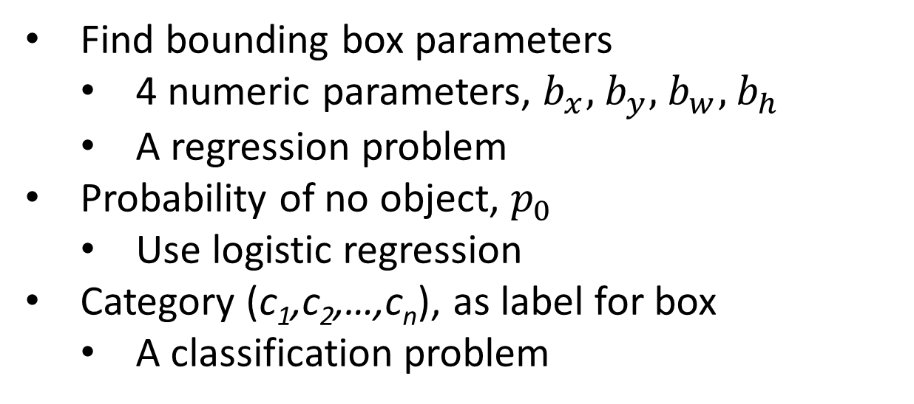
Solving Object Detection Problem
Solve as object detection as regression problem
Find bounding box parameters
4 numeric parameters, $b_{x},$ $b_{y},$ $b_{w},$ $b_{h}$
A regression problem
Probability of no object, $p_{0}$
Use logistic regression
Category (c₁,c₂,…,c_{n}), as label for box
A classification problem

Slide 31

Solving Object Detection Problem
Solve as object detection as multi-task problem
Can formulate the problem with label for multiple bounding boxes.
Solve box regression problem and identification problem in one step
Can use fully convolutional neural networks

Slide 32
Solving Object Detection Problem
Solve as object detection as regression problem
Find most probable bounding box with non-max suppression algorithm:
Filter all boxes with p₀ below threshold, say 0.5
While( more than one overlapping box ):
Select the remaining boxes with the highest probability
Compute the IoU for overlapping bounding boxes
Compute probability of object in box, P(ci)
Suppress (filter out) bounding boxes with f(IoU, P(ci)) below threshold

Slide 33
Solving Object Detection Problem
Find most probable bounding box with non-max suppression algorithm (NMS):
Most bounding boxes will not optimally contain an object
Imbalance with many more true negatives than true positives
Can lead to poor model training
SSD algorithm solves this problem with a hard negative mining algorithm:
Sort bounding boxes by confidence score
Retain only most confident cases to maintain a 3:1 ratio of negative to positive cases.
HNM is applied in other object detection algorithms

Slide 34
Loss functions for object detection
How can we construct a multi-task loss function for this problem?
Sequential or two step object detection algorithm
First step identify bounding box
Second step classify objects
Each step trained individually with specific loss function
Examples include R-CNN algorithm family
Multiple steps are inherent performance bottleneck
One step object detection algorithm
Use a multi-task loss function for training
Used in real-time algorithms; e.g. SSD and YOLO
Suitable for video rates
Trade-off accuracy for speed

Slide 35
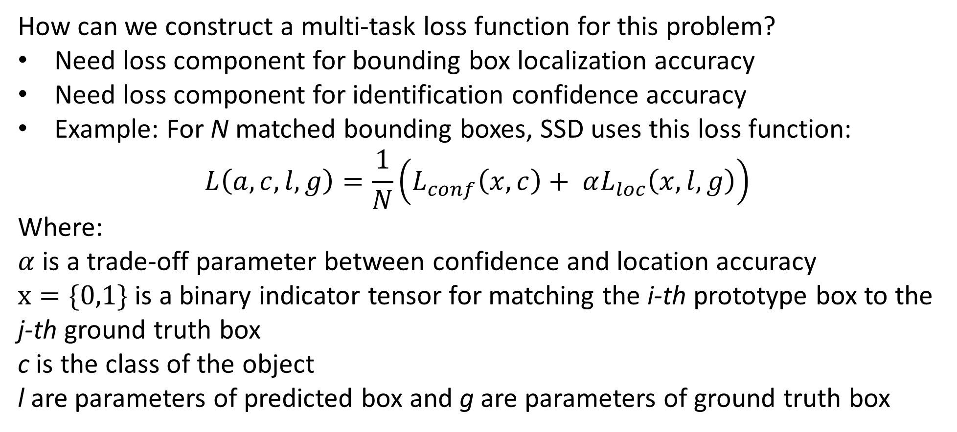
Loss functions for object detection
How can we construct a multi-task loss function for this problem?
Need loss component for bounding box localization accuracy
Need loss component for identification confidence accuracy
Example: For N matched bounding boxes, SSD uses this loss function:
$$L\left(a,c,l,g\right)=\frac{1}{N}\left(L_{conf}\left(x,c\right)+ αL_{loc}\left(x,l,g\right)\right)$$
Where:
$α$ is a trade-off parameter between confidence and location accuracy
$x=\{0,1\}$ is a binary indicator tensor for matching the i-th prototype box to the j-th ground truth box
c is the class of the object
l are parameters of predicted box and g are parameters of ground truth box

Slide 36
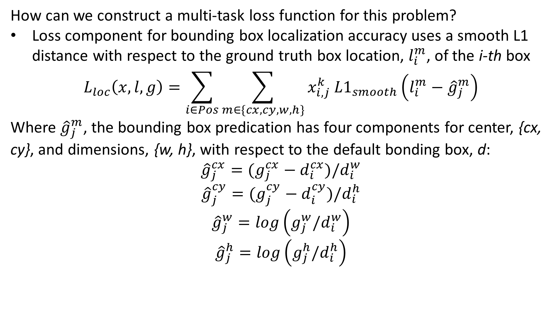
Loss functions for object detection
How can we construct a multi-task loss function for this problem?
Loss component for bounding box localization accuracy uses a smooth L1 distance with respect to the ground truth box location, $l_{i}^{m}$, of the i-th box
$$L_{loc}\left(x,l,g\right)=\sum_{i∈Pos}^{ }{\sum_{m∈\{cx,cy,w,h\}}^{ }{x_{i,j}^{k} {L1}_{smooth}\left(l_{i}^{m}−{\hat{g}}_{j}^{m}\right)}}$$
Where ${\hat{g}}_{j}^{m}$, the bounding box predication has four components for center, {cx, cy}, and dimensions, {w, h}, with respect to the default bonding box, d:
$${\hat{g}}_{j}^{cx}=(g_{j}^{cx}−d_{i}^{cx})/d_{i}^{w}$$
$${\hat{g}}_{j}^{cy}=(g_{j}^{cy}−d_{i}^{cy})/d_{i}^{h}$$
$${\hat{g}}_{j}^{w}=log\left(g_{j}^{w}/d_{i}^{w}\right)$$
$${\hat{g}}_{j}^{h}=log\left(g_{j}^{h}/d_{i}^{h}\right)$$

Slide 37
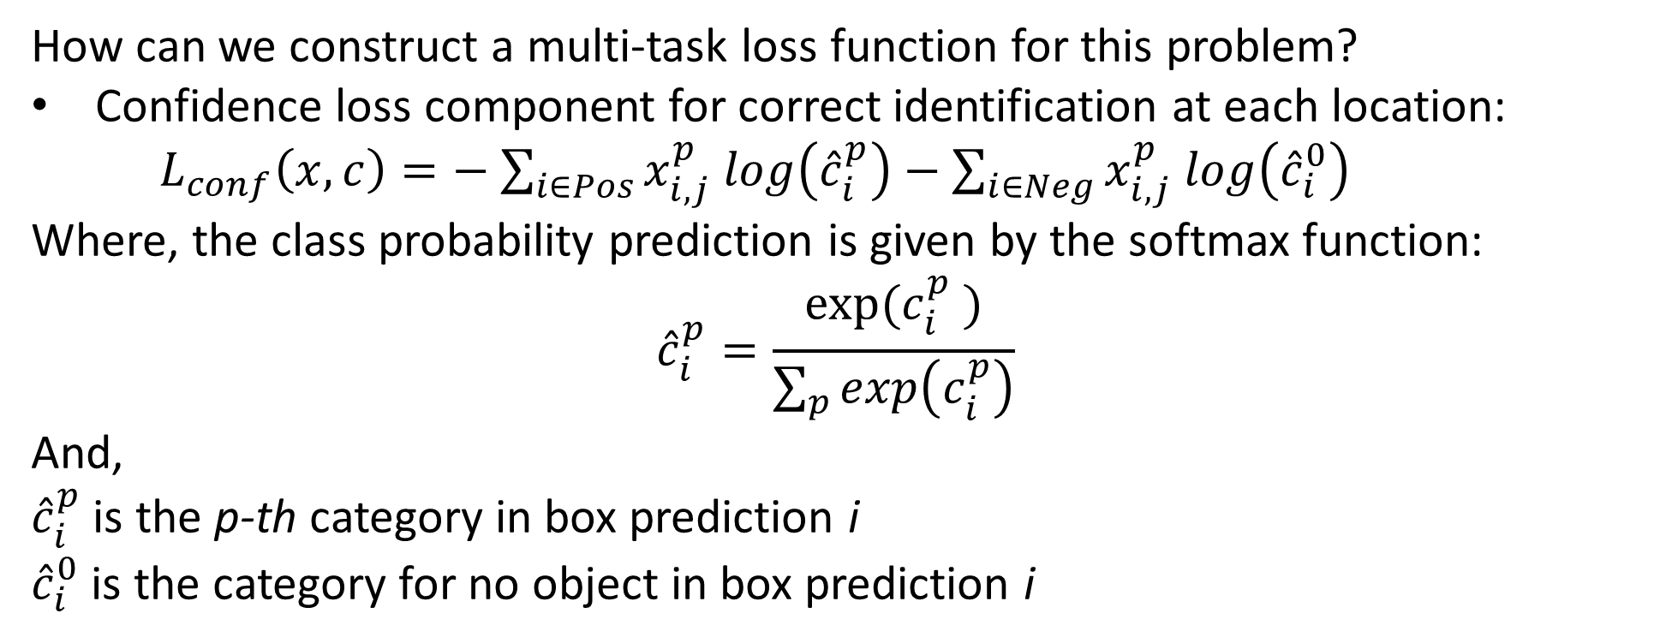
Loss functions for object detection
How can we construct a multi-task loss function for this problem?
Confidence loss component for correct identification at each location:
$L_{conf}\left(x,c\right)=−$ $\sum_{i∈Pos}^{ }{x_{i,j}^{p} log\left({\hat{c}}_{i}^{p}\right)}−\sum_{i∈Neg}^{ }{x_{i,j}^{p} log\left({\hat{c}}_{i}^{0}\right)}$
Where, the class probability prediction is given by the softmax function:
$${\hat{c}}_{i}^{p}=\frac{exp⁡({c_{i}^{p}}_{ }^{ })}{\sum_{p}^{ }{exp\left(c_{i}^{p}\right)}}$$
And,
${\hat{c}}_{i}^{p}$ is the p-th category in box prediction i
${\hat{c}}_{i}^{0}$ is the category for no object in box prediction i

Slide 38
Loss Functions for Object Detection
Class imbalance with object detection
Class imbalance is a significant problem when training object detection models
Example: Foreground objects are generally only a small fraction of pixels
Example: Many types of small-area background categories – e.g. stripes on a road
To overcome class imbalance problems, Li, et. al., use two approaches:
Focal loss is applied in the position head
Training the end-to-end network uses Dice loss

Slide 39
Loss Function for Object Detection
Dice-Sørensen coefficient, or Dice loss, is considered more robust to class imbalance
For two sets, $A$, $B$, the Dice-Sørensen coefficient is defined:
$$DC=\frac{2\left|A⋂B\right|}{\left|A\right|+\left|B\right|}$$
For the simple case of binary classification, we write Dice loss:
$$DL\left(y,\hat{p}\right)=1−\frac{2y\hat{p}+1}{y+\hat{p}+1}$$
Where:
$y=$ label
$\hat{p}=$ Binary category prediction
Dice loss is equivalent to F1 loss
Full details on loss functions for training semantic segmentation models can be found in Jadon, 2020, or Jeremy Jordan’s blog post

Slide 40
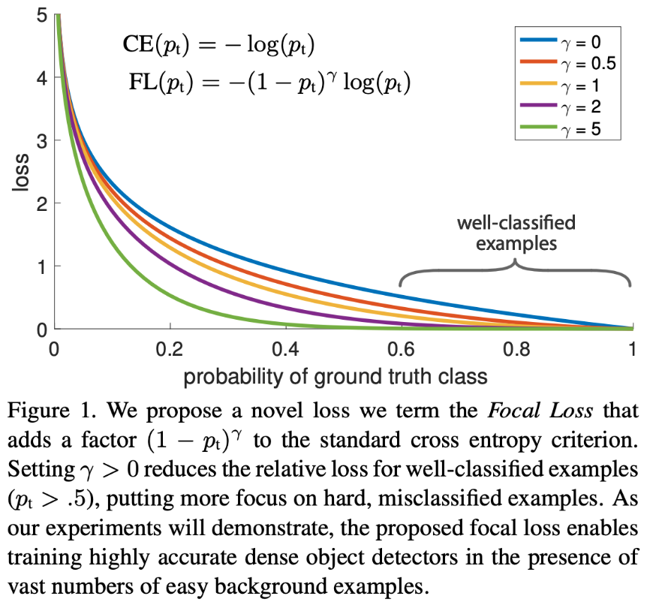
Loss Function for Object Detection
Focal loss addresses class imbalance by reweighting cross-entropy
We can write binary cross-entropy in the well known form:
$$CE\left(y,\hat{p}\right)=CE\left(\hat{p_{t}}\right)=−log\left(\hat{p_{t}}\right)$$
Focal loss reweights cross-entropy:
$$FL\left(y,\hat{p}\right)={−\left(1−\hat{p_{t}}\right)}^{γ}log\left(\hat{p_{t}}\right)$$
- Where:
$γ=$ hyperparameter, $0≤γ$
$γ=0, FC=$ cross-entropy
The ${\left(1−\hat{p_{t}}\right)}^{γ}$ term down-weights easy to learn categories
Find many more details in Lin, et. al, 2018

Slide 41
Evaluation of object detection
Need multiple criteria to evaluate object detection
Is there an object in the box?
Is the bounding box correct?
Is the object classification in the box correct?
Need metrics for accuracy of bounding box and object class predictions
Average precision measured on recall-precision trade-off curve
Use mean average precision – mAP
Mean taken over average precision over all object classes

Slide 42
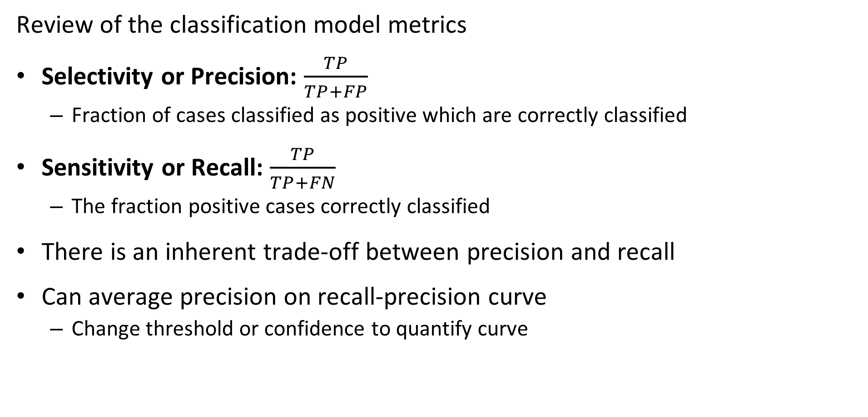
Evaluation of object detection
Review of the classification model metrics
Selectivity or Precision: $\frac{TP}{TP+FP}$
Fraction of cases classified as positive which are correctly classified
Sensitivity or Recall: $\frac{TP}{TP+FN}$
The fraction positive cases correctly classified
There is an inherent trade-off between precision and recall
Can average precision on recall-precision curve
Change threshold or confidence to quantify curve

Slide 43
Evaluation of object detection
Computing Average Precision - AP
Precision decreases as recall increases
Recall increases as confidence (IoU) increases
Average precision is Area Under the Curve (AUC) of precision-recall curve
Approximate AUC as sum of area of rectangles at each threshold sample
Usually sample precision at 10 threshold (IoU) values
Precision
Increasing threshold, IoU
Increasing Recall

Slide 44
Evaluation of object detection
Computing mean average precision - mAP
Compute average precision for each of c classes
Compute mean of precision for all c classes
Report mAP as percentage
Prefect performance = 100%
No correct detection and classification = 0%

Slide 45
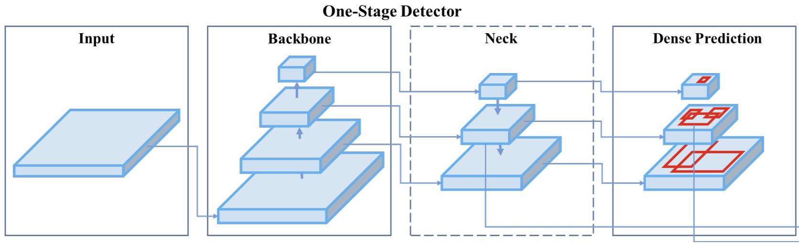
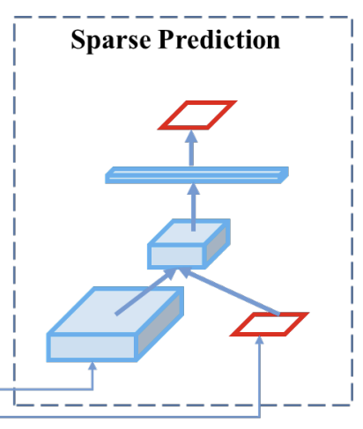
Architectures of object detectors
Architectural components of single shot object detectors: Example YOLOv4
Architectural components of single shot object detectors
Backbone convolutionally NN creates the feature map
Neck to accommodate multiple scales
Head detects objects and identifies them
Sparse Prediction applies non-maximal suppression

Slide 46
Backbones: CNNs Create Feature Maps
Many choices have been tried
VGG-16
ResNet-52
EfficientNet-BO/B7
Darknet-53
Others…

Slide 47
Neck: Working with multiple scales
Images contain objects a multiple scales
Need to detect objects across wide range of scale
Is trade-off between semantics and detail
Large scale has better semantics
Fine scale has more detail
Deep neural network architecture produces multiple scales
Convolution with max pooling reduces detail
Deeper layers with better semantics

Slide 48
Neck: Working with multiple scales
Images contain objects a multiple scales
Need to detect objects across wide range of scale
Is trade-off between semantics and detail
Large scale has better semantics
Fine scale has more detail
Deep neural network architecture produces multiple scales
Convolution with max pooling reduces detail
Deeper layers with better semantics

Slide 49

Neck: Working with multiple scales
Convolutional neural network with multi-scale feature map (pyramid)
Predict
Convolution/max-polling layers
Predict
Multi-scale bounding boxes
Predict
Image
Convolution/up-sampling
Head for detection and identification
Backbone Convolutional Layers
Creates feature map
Convolutional Layers of neck
Multiple scales

Slide 50

Straight-Through Architectures
Example Single Shot Detector, SSD
SSD takes a different approach to the speed-accuracy trade-off
SSD achieves efficiency by scoring multiple bounding boxes at different scales simultaneously using convolutional layers

Slide 51
Straight-Through Architectures
Example Single Shot Detector, SSD
SSD is a fully convolutional network
No fully connected layers

Slide 52
Straight-Through Architectures
Example Single Shot Detector, SSD
VGG-16 Backbone Convolutional Layers
Creates feature map

Slide 53
Straight-Through Architecture
Example Single Shot Detector, SSD
Convolutional Layers of neck down sample to multiple scales
Detection and classification on grids

Slide 54
Straight-Through Architectures
Example Single Shot Detector, SSD
Head layers
Output for each box and class

Slide 55
Straight-Through Architectures
Architectural components of single shot object detectors: Example YOLOv4
Architectural components of single shot object detectors
Backbone DarkNet-53 creates the feature map
Neck to accommodate multiple scales
Head detects objects and identifies them
Sparse Prediction applies non-maximal suppression
Figure from Bochkovskiy, et. al., 2020

Slide 56
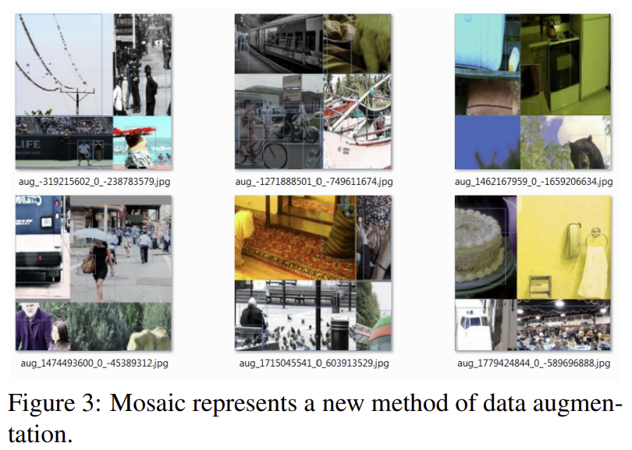
YOLOv4
YOLOv4 incorporates multiple improvements for better performance
YOLOv4 introduced mosaic data augmentation
Mosaic created from patches of several images
Gives greater diversity of backgrounds and objects in augmented images
Figure from Bochkovskiy, et. al., 2020

Slide 57
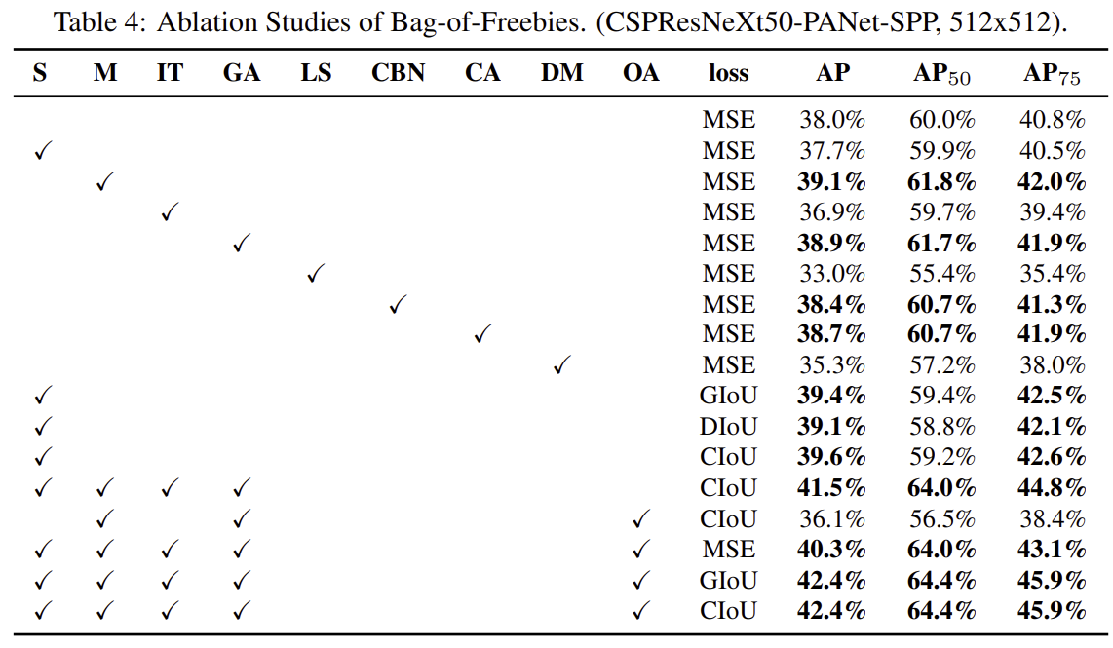
YOLOv4
YOLOv4 incorporates multiple improvements for better performance
S = Sensitivity for bounding box
M = Mosaic augmentation
IT = Multiple anchors for single ground truth
GA = Genetic algorithm for network model selection
OA = Optimized anchors for 512 x 512 image
Figure from Bochkovskiy, et. al., 2020

Slide 58
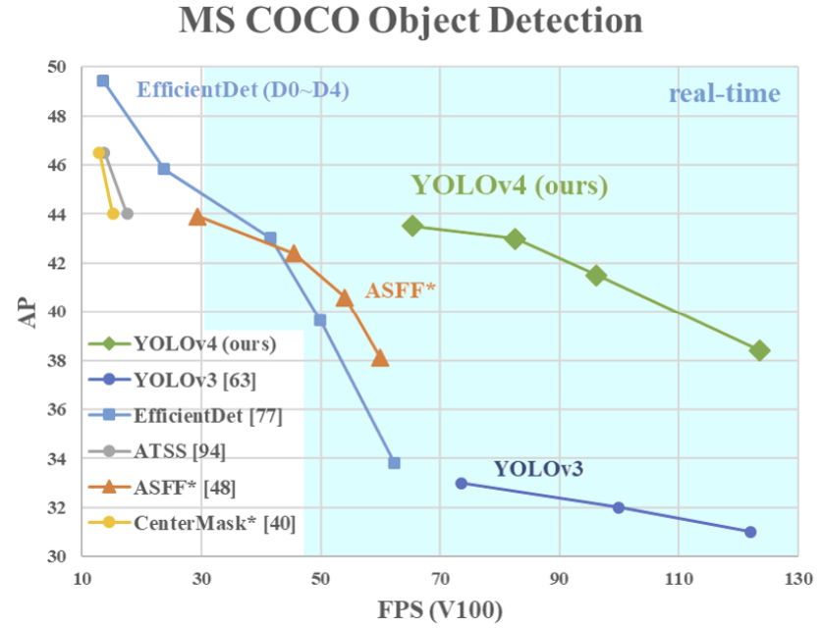
YOLOv4
YOLOv4 incorporates multiple improvements for better performance
Figure from Bochkovskiy, et. al., 2020

Slide 59
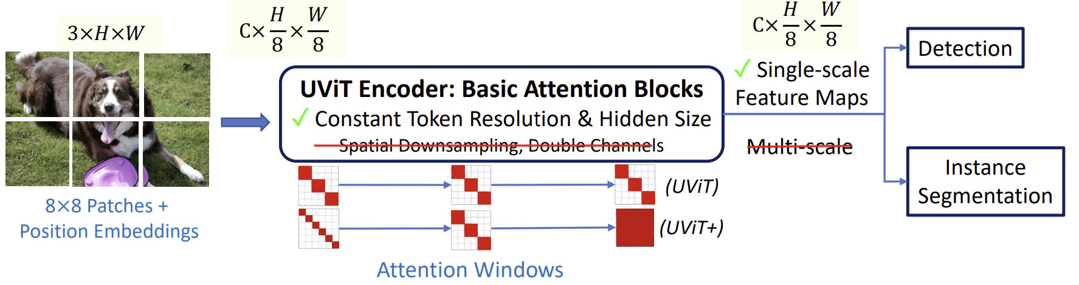
Transformer Architecture for Object Detection
Chen, et. al., 2022 proposed a simplified transformer architecture for dense CV tasks
Pure ViT transformer architecture to create feature map
Task specific heads
Constant window size (UViT) or increasing window size with depth (+) to achieve high density efficiently

Slide 60
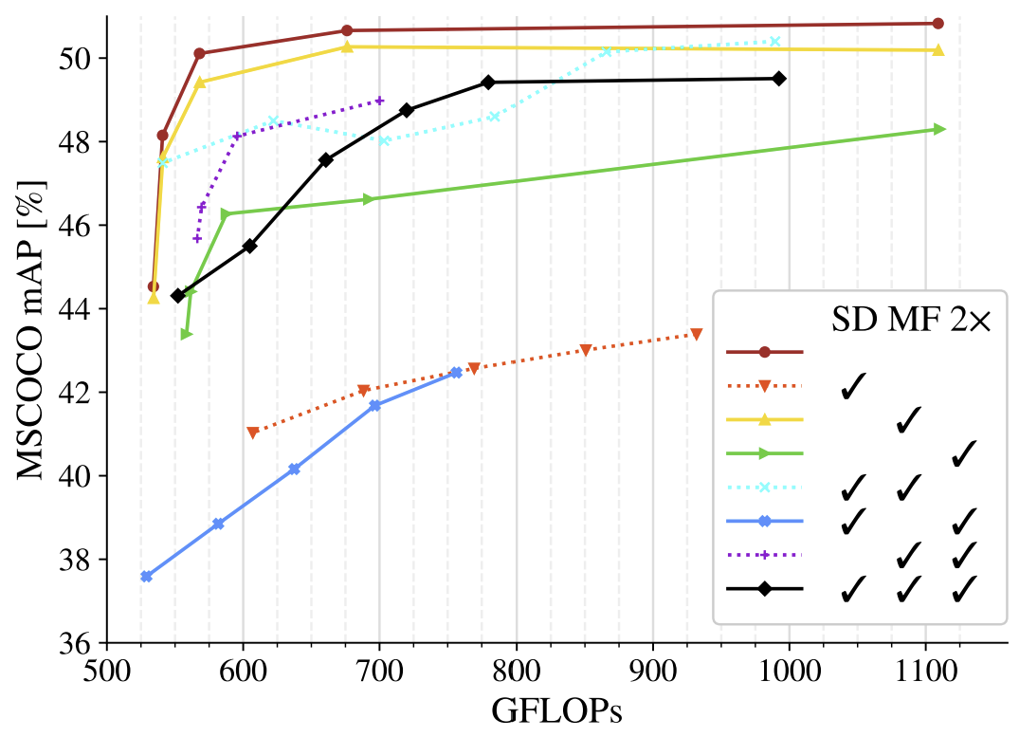
Transformer Architecture for Object Detection
Chen, et. al., 2022 showed simple architecture is superior to more complex hand-engineered architectures
SD = Spatial down-sampling
MF = Multi-scale features
2x = Doubled channels

Slide 61
Transformer Architecture for Object Detection
Chen, et. al., 2022 showed simple architecture is superior to more complex hand-engineered architectures
SD = Spatial down-sampling
MF = Multi-scale features
2x = Doubled channels

Slide 62
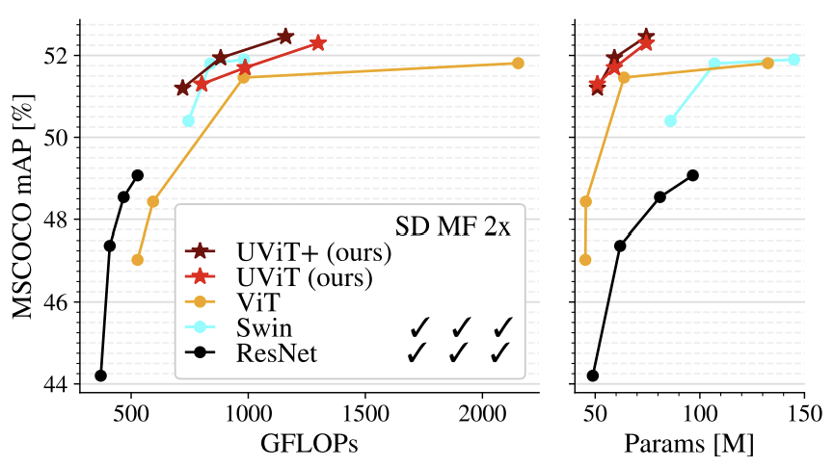
Transformer Architecture for Object Detection
Chen, et. al., 2022 propose transformer architecture which may be a path for future dense CV tasks
How well does the pure transformer model work?

Slide 63
Summary
Elements of object detection algorithms
Parameterization of bounding boxes, maintain stability
Multiple prior (anchor) bounding boxes
Evaluation of object detection algorithms, mAP
Solving the object detection problem, multi-task loss functuion
Working with multiple scales
Single-shot algorithms for video
Transformer architecture

